Slide 1
Statistics for linguists
2023-12-06
Chi-squared test, loglinear models

Slide 2
From last class
Linear models
Errors and residuals
Sum of squares
ANOVA

Slide 3
For this class
Directed acyclic graphs (introduction)
Chi-squared test
Loglinear model / logistic regression
Some data wrangling (splitstr etc.)

Slide 4
Packages for today
library(tidyverse)
library(ggdag)
library(V8)
library(dagitty) library(glm2)
library(Rling) library(rms)
library(visreg) library(car)

Slide 5
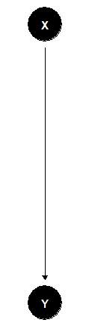
Directed acyclic graph
A directed acyclic graph represents our assumptions about causal direction.
When you use a statistical model you imply assumptions about causation between your variables.
So far, we have just been dealing with very simple causal relations (simple ‘bivariate’ models)
read as ‘X causes Y’

Slide 6
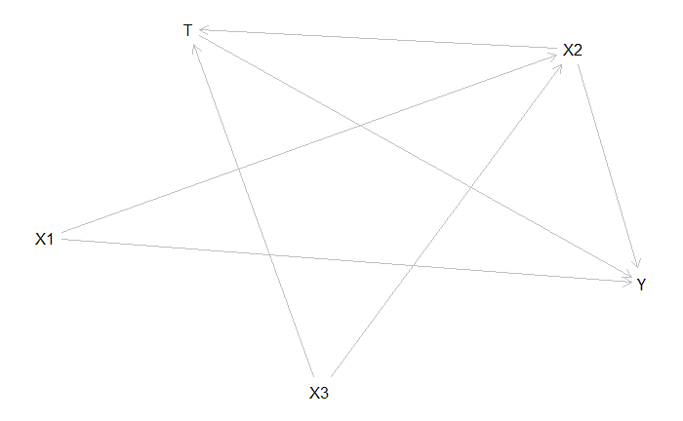
Directed acyclic graph (DAG)
The causal relations can get very complicated though.
DAGs are used for causal inference – if your statistical model is paired with DAG it means you can infer causation from your model, rather than just correlation
Pearl, Judea. 2009. Causality: Models, Reasoning and Inference. Cambridge: Cambridge University Press.

Slide 7


Causal inference & the Causal revolution
Pearl, Judea. 2009. Causality: Models, Reasoning and Inference. Cambridge University Press.
Pearl, Judea (with Dana Mackenzie). The book of Why: The new science of cause and effect. Penguin.

Slide 8
Direct acyclic graph
Linear model / Regression
X = continuous
Y = continuous
ANOVA
X is categorical
Y is continuous
read as X causes Y

Slide 9
Direct acyclic graph
Linear model / Regression
X = continuous
Y = continuous
ANOVA
X is categorical
Y is continuous
Chi-squared
X is categorical
Y is categorical
Loglinear model / Logistic regression
X is continuous
Y is categorical
read as X causes Y

Slide 10
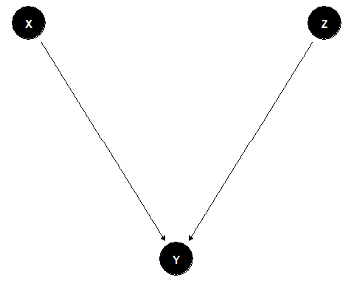
Directed acyclic graph
Naturally there can be more than one cause
Next week we will start looking at multivariate models in more detail

Slide 11
coord_dag <- list( x = c(X = 2, Y = 2), y = c(X = 3, Y = 1) ) our_dag <- ggdag::dagify(Y ~ X, coords = coord_dag) ggdag::ggdag(our_dag) + theme_void()
dag <- dagitty("dag { X1 -> X2 X1 -> Y X3 -> X2 X2 -> Y X2 -> T -> Y X3 -> T }") plot( graphLayout( dag ) )
coord_dag <- list( x = c(X = 1, Y = 2, Z = 3), y = c(X = 3, Y = 1, Z = 3) ) our_dag <- ggdag::dagify(Y ~ X, Y ~ Z, coords = coord_dag) ggdag::ggdag(our_dag) + theme_void()

Slide 12
Counts & contingency tables
A lot of statistical information comes from counts (e.g. frequency of words in different texts)
The data are usually presented in a contingency table.
Data from Matthew Dryer (1992)
OV = Object-Verb words order / VO = Verb-Object word order
Postp = positions / Prep = prepositions
H1:postpositions are associated with OV word order and prepositions are associated with VO order
Dryer, Matthew S. 1992. The Greenbergian Word Order Correlations. Languages 68:1, 81-138.

Slide 13
Contingency table (word order associations)
 | OV | VO
Postp | 107 | 12
Prep | 7 | 70
adpos <- matrix(c(107,12,7,70),ncol=2,byrow=TRUE) rownames(adpos)<-c("PostP","Prep") colnames(adpos)<-c("OV","VO") adpos
Dryer, Matthew S. 1992. The Greenbergian Word Order Correlations. Languages 68:1, 81-138.

Slide 14
Counts and probabilities
These are observed frequencies
We now need a model that predicts the expected frequencies
Using these data, what is the probability of a random language from this sample having OV?
Dryer, Matthew S. 1992. The Greenbergian Word Order Correlations. Languages 68:1, 81-138.

Slide 15
Counts and probability
wordorder <- cbind(c(107, 7), c(12, 70)) rownames(wordorder) <- c("Postp", "Prep") colnames(wordorder) <- c("OV", "VO") wordorder <- rbind(wordorder, c(114,82)) wordorder <- cbind(wordorder, c(119,77,196)) rownames(wordorder) <- c("PostP", "Prep", "Column Total") colnames(wordorder) <- c("OV", "VO", "Row total") wordorder
Crawley, Michael J. 2015. Statistics: An Introduction using R. Wiley.

Slide 16
Expected Frequency
Raw total (Postp = 119, Prep = 77)
Column total (OV = 114, VO = 82)
Grand total = 196
Expected = (Raw total * Column total) / Grand total
Crawley, Michael J. 2015. Statistics: An Introduction using R. Wiley.
Dryer, Matthew S. 1992. The Greenbergian Word Order Correlations. Languages 68:1, 81-138.

Slide 17
Expected frequency
The expected frequency refers to what the values would be if VO/OV and Postp/Prep were independent.
 | OV | VO
Postp | (114*119)/196 | (82*119)/196
Prep | (114*77)/196 | (82*77)/196
E <- cbind(c((114*119)/196, (114*77)/196), c(82*119/196,(82*77)/196)) rownames(E) <- c("Postp", "Prep") colnames(E) <- c("OV", "VO") E
Crawley, Michael J. 2015. Statistics: An Introduction using R. Wiley.

Slide 18
Expected frequency
What we’ve done is created a hypothetical “null distribution” against which we can measure how surprising our actual data are.
 | OV | VO
Postp | 69.21429 | 49.78571
Prep | 44.78571 | 32.21429
Crawley, Michael J. 2015. Statistics: An Introduction using R. Wiley.

Slide 19
Expected frequency vs. real frequencies
What we’ve done is created a hypothetical “null distribution” against which we can measure how surprising our actual data are.
 | OV | VO
Postp | 69.21429 | 49.78571
Prep | 44.78571 | 32.21429
 | OV | VO
Postp | 107 | 12
Prep | 7 | 70

Slide 20
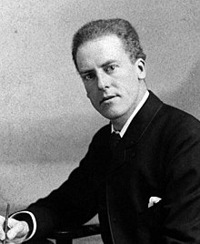

Chi-squared test
The classical way of doing this is Karl Pearson’s chi-squared test.
$$χ^{2}=\sum{\frac{{\left(Observed−Expected\right)}^{2}}{Expected}}$$
https://upload.wikimedia.org/wikipedia/commons/2/21/Karl_Pearson_2.jpg
Crawley, Michael J. 2015. Statistics: An Introduction using R. Wiley.

Slide 21
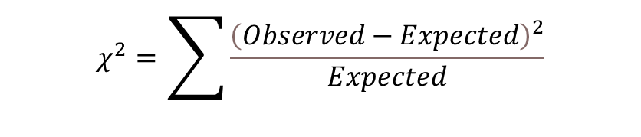

E <- cbind(c((114*119)/196, (114*77)/196), c(82*119/196,(82*77)/196)) rownames(E) <- c("Postp", "Prep") colnames(E) <- c("OV", "VO") E
$$Expected=\frac{Rowtotal∗Columntotal}{Grandtotal}$$
E.df <- melt(E)
colnames(E.df)<-c("Adposition", "Verb.Object", "Expected.Frequency") E.df$Observed.Frequency <- c(107,7,12,70) E.df
Putting expected and observed data in the same data set
E.df$oe <- ((E.df$Observed.Frequency - E.df$Expected.Frequency)^2) / E.df$Expected.Frequency sum(E.df$oe)
$$χ^{2}=\sum{\frac{{\left(Observed−Expected\right)}^{2}}{Expected}}$$

Slide 22
Chi-squared test and p values
Is this number big?
What is the critical value of the chi-squared test?
To calculate this, we need the degrees of freedom and the cut off area you want.
R = number of rows
C = number of columns
Crawley, Michael J. 2015. Statistics: An Introduction using R. Wiley.

Slide 23
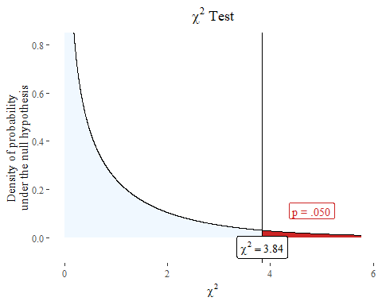
Chi-squared test and p-value
We have another hypothetical distribution based like the t distribution.

Slide 24
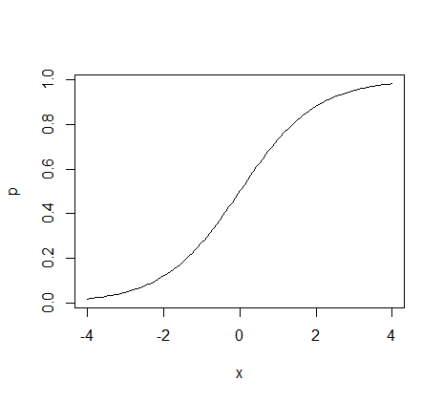
Logistic regression

Slide 25
Logistic regression
The logistic regression is a method for modelling binary data.
The basic ideas can be extended to non-binary data as long as they are organized into levels.
It is typically used when the dependent variable is binary and there is an interest in knowing how a change in x effects the probability that something is y.

Slide 26
Logistic regression
Psycholingustic experiments where subjects have to give yes or no answers.
Various uses in natural language processing
Predict the risk of developing a specific disease
Predict the probability that someone will vote for a particular political party.
...

Slide 27
Field experiment
Let’s look at data with a binary response variable.
A multiple forced choice test was used with Chácobo speakers in 2022 using Praat
Pitch and duration values of a form janáquë [hanákɨ] were manipulated systematically to create a matrix of duration and pitch values.
Speakers Heard these and had to guess whether they were hearing jánaquë ’s/he left it’ or janáquë ’s/he vomited’
https://www.fon.hum.uva.nl/praat/manual/ExperimentMFC.html

Slide 28
Multiple forced choice experiment
You’ll have to wrangle the data a bit.
mcf <- read.csv(“YourPathway/chacobo.mcf.df.csv")
response <- ifelse(mcf$response=="janáquë vomitó", 1, 0) stimulus <- str_remove_all(mcf$stimulus, "janaquë_") df <- as.data.frame(cbind(response, stimulus)) df[c("Pitch_Hz", "Duration_ms")] <- str_split_fixed(df$stimulus, "_", 2) df$Pitch_Hz<-as.numeric(df$Pitch_Hz) df$response <- as.numeric(df$response) head(df)

Slide 29
mcf <- read.csv(“YourPathway/chacobo.mcf.df.csv")
response <- ifelse(mcf$response=="janáquë vomitó", 1, 0)
stimulus <- str_remove_all(mcf$stimulus, "janaquë_")
df <- as.data.frame(cbind(response, stimulus))
df[c("Pitch_Hz", "Duration_ms")] <- str_split_fixed(df$stimulus, "_", 2)
df$Pitch_Hz<-as.numeric(df$Pitch_Hz)
df$response <- as.numeric(df$response)
head(df)
Change values so that they are 0 or 1
Extract the pitch and duration values from the stimuli
Make the values numeric

Slide 30
Linear model
You could run a normal linear model on these data once the response variable is coded as 0 or 1.
It is not very realistic or well-fit – but let‘s illustrate this anyways.
ggplot(df, aes(jitter(Pitch_Hz), jitter(response))) + geom_point()+ stat_smooth(method="lm", formula = y ~ x, geom= "smooth")+ ylim(0,1)
Note that we use jitter() when lots of data points are overlapping so we can see the distribution.

Slide 31
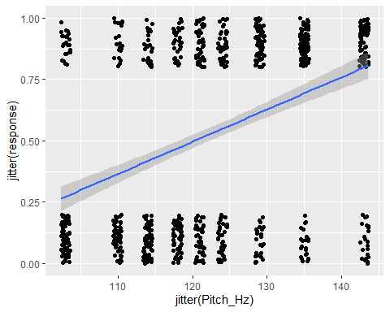
Normal linear model
You can see that as the pitch increases on the second vowel, the probability that janáquë ’vomit’ = 1 is chosen over jánaquë ’leave’ = 0 increases.
But the linear model makes predictions way beyond the structure of the data.

Slide 32
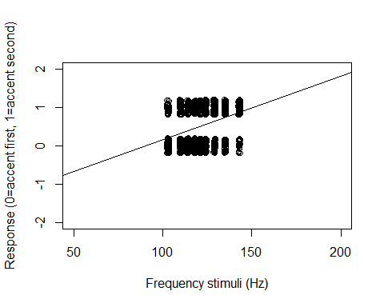
plot(jitter(df$response)~jitter(df$Pitch_Hz), ylab="Response (0=accent first, 1=accent second)", xlab ="Frequency stimuli (Hz)", xlim=c(50,200), ylim=c(-2,2)) +
abline(lm(response ~ Pitch_Hz, data = df))

Slide 33
Asymptotic function
To model probability of one answer over another in relation to some data point x, we want a line that has asymptotic properties
Asymptotic function: A function which gets closer and closer to a value or condition but never reaches it.
Why? The difference between 125 and 150 Hz should be huge in terms of predicting the response but the difference between 150 and 175 Hz should be smaller.

Slide 34
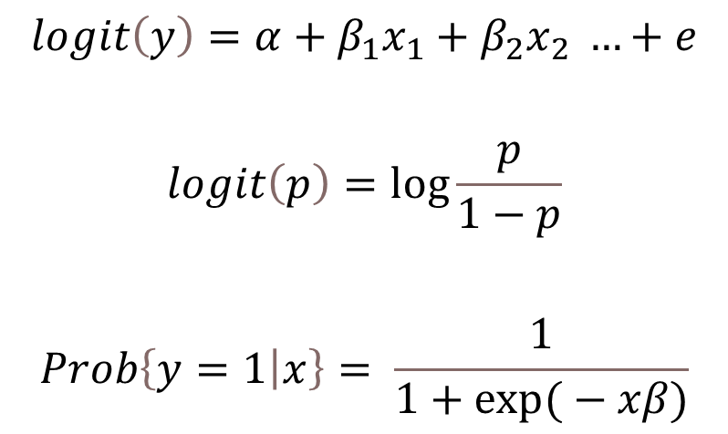
Logistic regression
A logistic regression or logit model can be represented with the following equations ....
$$logit\left(y\right)=α+β_{1}x_{1}+β_{2}x_{2} …+e$$
$$logit\left(p\right)=\log{\frac{p}{1−p}}$$
$$Prob\left\{y=1 | x\right\}= \frac{1}{1+\exp{(}−xβ)}$$

Slide 35

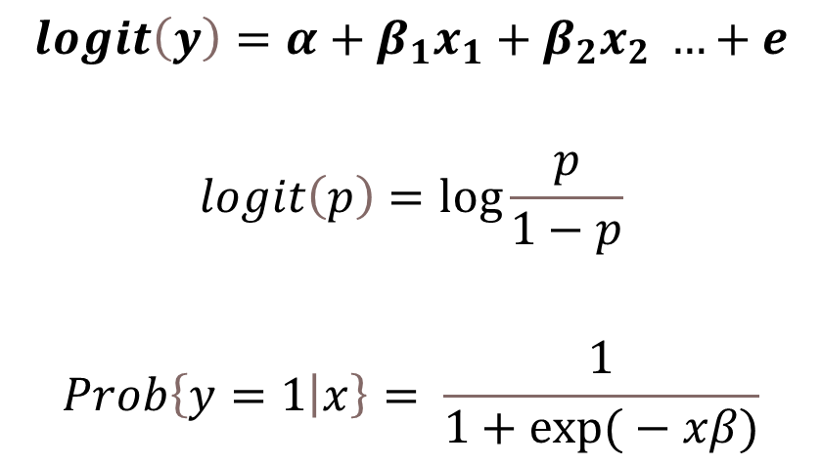
Logistic regression
A logistic regression or logit model can be represented with the following equations ....
$$logit\left(y\right)=α+β_{1}x_{1}+β_{2}x_{2} …+e$$
$$logit\left(p\right)=\log{\frac{p}{1−p}}$$
$$Prob\left\{y=1 | x\right\}= \frac{1}{1+\exp{(}−xβ)}$$
The intercept plus the coefficient $β$ times x (plus error etc.) is equal to y output from a logit function

Slide 36
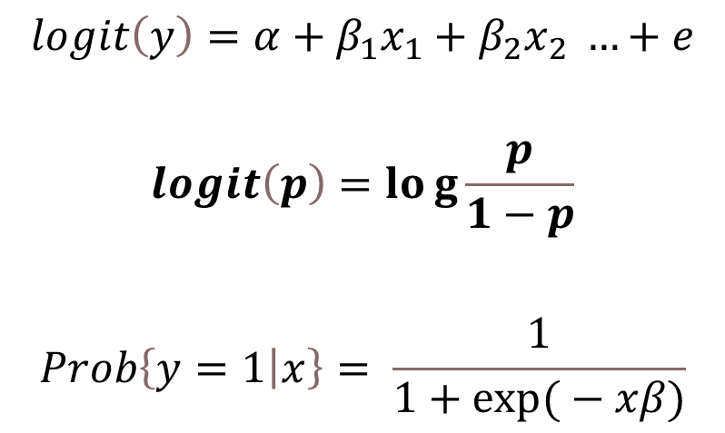
Logistic regression
A logistic regression or logit model can be represented with the following equations ....
$$logit\left(y\right)=α+β_{1}x_{1}+β_{2}x_{2} …+e$$
$$logit\left(p\right)=log{\frac{p}{1−p}}$$
$$Prob\left\{y=1 | x\right\}= \frac{1}{1+\exp{(}−xβ)}$$
The logit function is the log of a probability divided by 1 minus that probability – the “log odds”

Slide 37
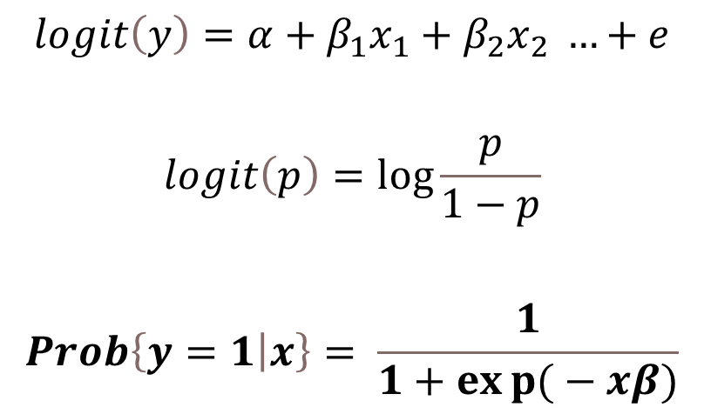
Logistic regression
A logistic regression or logit model can be represented with the following equations ....
$$logit\left(y\right)=α+β_{1}x_{1}+β_{2}x_{2} …+e$$
$$logit\left(p\right)=\log{\frac{p}{1−p}}$$
$$Prob\left\{y=1 | x\right\}= \frac{1}{1+exp{(}−xβ)}$$
So to get the probability that y is 1 given x, you divide the loglinear variables by an equation that reverses the logit function.

Slide 38
Logistic regression
A logistic regression or logit model can be represented with the following equations ....
$$logit\left(y\right)=α+β_{1}x_{1}+β_{2}x_{2} …+e$$
$$logit\left(p\right)=\log{\frac{p}{1−p}}$$
$$Prob\left\{y=1 | x\right\}= \frac{1}{1+exp{(}−xβ)}$$
Just algebra
So to get the probability that y is 1 given x, you divide the loglinear variables by an equation that reverses the logit function.

Slide 39

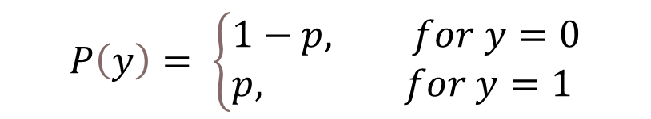
Bernouilli distribution
A Bernouilli distribution is a discrete distribution with two possible outcomes.
We want to account for the distribution of y.
You can model it with rbinom()
$$P\left(y\right)= \left\{\begin{aligned}&1−p, for y=0 \\ &p, for y=1\end{aligned}\right.$$
By Niklaus Bernoulli (1662-1716) - [2] [3], Public Domain, https://commons.wikimedia.org/w/index.php?curid=266673

Slide 40
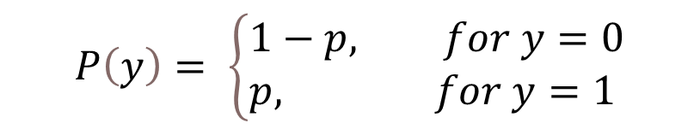
Bernouilli distribution
A Bernouilli distribution is a discrete distribution with two possible outcomes.
We want to account for the distribution of y.
You can model it with rbinom()
$$P\left(y\right)= \left\{\begin{aligned}&1−p, for y=0 \\ &p, for y=1\end{aligned}\right.$$
‘The probability of y being 1 is p and the probability of y being 0 is p – 1’

Slide 41
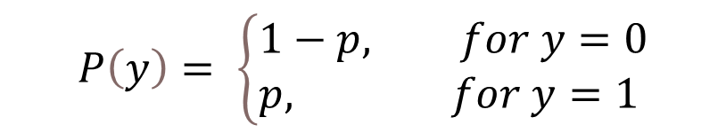
Bernouilli distribution
A logistic regression or logit model can be represented with the following equations ....
$$P\left(y\right)= \left\{\begin{aligned}&1−p, for y=0 \\ &p, for y=1\end{aligned}\right.$$
bernouilli_data <- rbinom(20, 1, 0.5) print(bernouilli_data)
## [1] 1 1 1 0 0 1 0 0 1 0 0 1 0 0 0 1 0 0 0 1

Slide 42

Logistic function
$$logit\left(p\right)=\log{\frac{p}{1−p}}$$
The important point about log odds ratios as that they take any numbers and transform them to a number from 0 to 1 along a sigmoid shape.
Why is this good?
Because we are interested in modelling a binary outcome,0 or 1, and we want to have a function that translates the effect of predictors into that scale for y.

Slide 43

Logistic function
Any value of x will be transformed into a number that varies from 0 to 1 with ceiling effects.
$$Prob\left\{y=1 | x\right\}= \frac{1}{1+\exp{(}−xβ)}$$

Slide 44
Logistic regression
y is bounded to 0 or 1
The relationship between x and y has a ceiling effect (like logarithms)
Let’s run a simulation model to get the feel for it.

Slide 45

Functions
There are two functions in R
The logarithmic function and the exponential function – they are basically mirror-images of each other.
The odds function is pretty straightforward
t <- log(10) t
## [1] 2.302585
exp(t)
## [1] 10
$$\frac{1}{1−p}$$

Slide 46
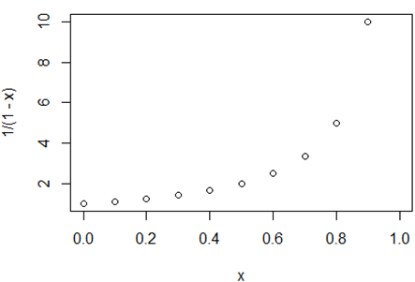
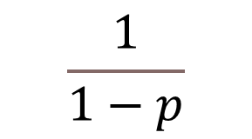
Odds
If you plot probabilities versus odds, you can see that odds has an asymptotic property in relation to probability
par(mfrow=c(1,1)) x <- seq(0,1,by=0.1)
plot(x, 1/(1-x))
$$\frac{1}{1−p}$$

Slide 47
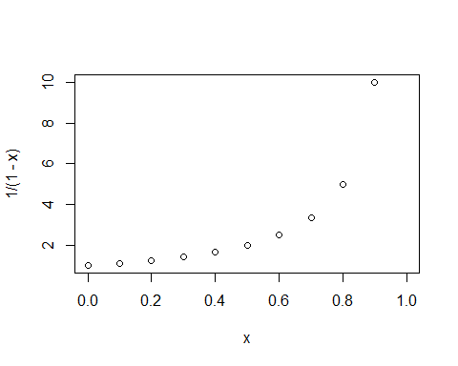
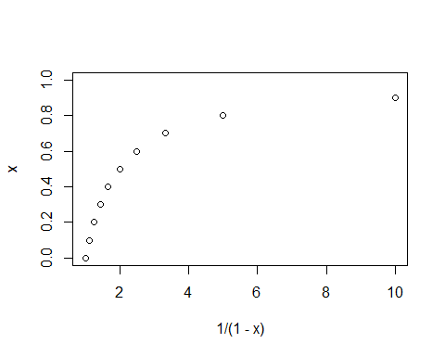
Plotting odds
plot(x, 1/(1-x))
plot(1/(1-x),x)

Slide 48
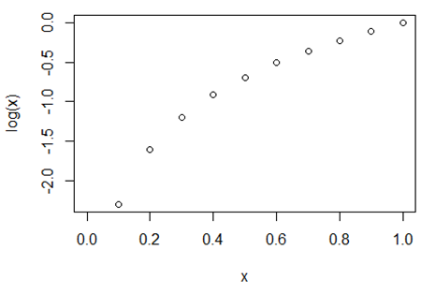
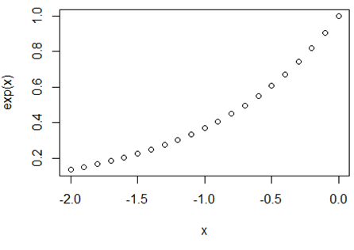
Logs
Logs also have this asymptotic property on both sides.
x <- seq(0,1,by=0.1) plot(x,log(x))
x <- seq(-2,0, by =.1) plot(x, exp(x))
But not exactly how we want because we want a ceiling effect approaching 0 and approaching 1

Slide 49
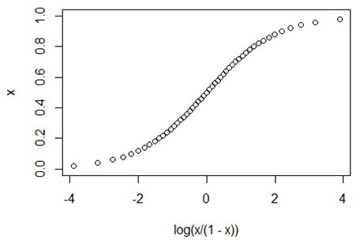
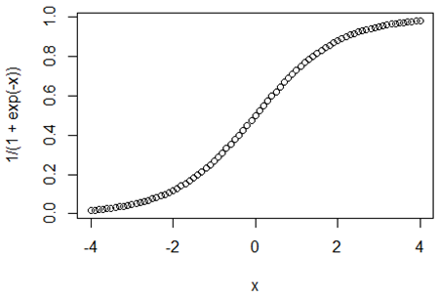
Log-odds
par(mfrow=c(1,1)) x <- seq(0,1,by=.02) plot(log(x/(1-x)),x)
par(mfrow=c(1,1)) x <- seq(-4,4,by=.1) plot(x, 1/(1+exp(-x)))

Slide 50
Slope of an S-curve
Does a slope make sense?
The slope changes as x changes – so there’s not a single slope.
There are concepts we can make use of (e.g. the slope at the steepest point of the curve)
It is hard to interpret coefficients in logistic regressions
Gelman, Andrew & Jennifer Hill. 2007. Data Analysis Using Regression and Multilevel/Hierarchical Models. Cambridge: Cambridge University Press.

Slide 51
Slope
Adding a slope coefficient
par(mfrow=c(2,2)) x <- seq(-4,4,by=.1) b <- 2 plot(x, 1/(1+exp(-x*b)), main = "b = 2") b <- 8 plot(x, 1/(1+exp(-x*b)), main = "b = 8") b <- 0.5 plot(x, 1/(1+exp(-x*b)), main = "b = 0.5") b <- -1 plot(x, 1/(1+exp(-x*b)), main = "b = -1")

Slide 52
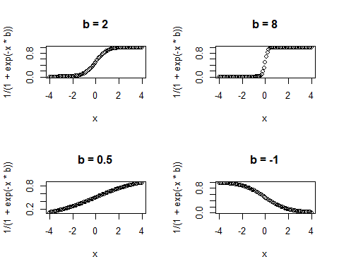
Slope of a logistic function
Intuitively, the slope corresponds to how steep the curve is around its center point
Large slope = small change in x is equal to a large change in the probability that y = 1 around the middle of the S-curve (where the slope is changing the fastest)

Slide 53
Simulation exercise
Simulate whether someone will go to class other not
set.seed(1) coffee <- rnorm(100, 15, 5) happiness <- rnorm(100, 10, 2) a <- -5 b1 <- -1 b2 <- 1
xb <- a + b1 * happiness + b2 * coffee + rnorm(100, 0, 0.1)
p <- 1/ (1+exp(-xb))

Slide 54

Simulation exercise
Simulate whether someone will go to class other not
set.seed(1) coffee <- rnorm(100, 15, 5) happiness <- rnorm(100, 10, 2) a <- -5 b1 <- -1 b2 <- 1
$$Prob\left\{y=1 | x\right\}= \frac{1}{1+\exp{(}−xβ)}$$
xb <- a + b1 * happiness + b2 * coffee + rnorm(100, 0, 0.1)
p <- 1/ (1+exp(-xb))
We have to subject our y to the inverse of the logit function to get the actual probabilities

Slide 55
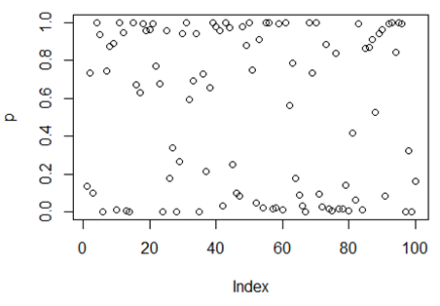
Simulation exercise
summary(p)
## Min. 1st Qu. Median Mean 3rd Qu. Max. ## 0.0000497 0.0780173 0.7105522 0.5493012 0.9611723 0.9999948
par(mfrow=c(1,1)) plot(p)

Slide 56
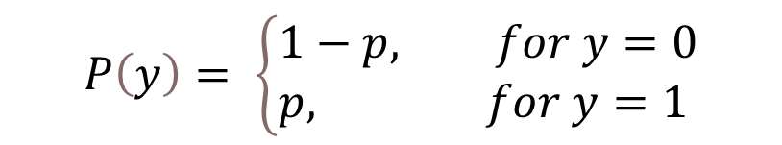
Simulation exercise
gotoclass <- rbinom(n=100, size=1, prob=p) gotoclass
## [1] 0 0 0 1 0 0 1 1 0 0 1 1 0 0 1 1 1 1 1 1 1 1 1 0 1 0 0 0 0 1 1 1 1 1 0 1 0 ## [38] 1 1 1 1 0 1 1 1 0 0 1 1 1 1 0 1 0 1 1 0 0 1 0 1 0 1 0 0 0 0 1 1 1 0 0 1 0 ## [75] 0 1 0 0 0 0 1 0 1 0 1 1 1 1 1 1 0 1 1 1 1 1 0 0 0 0
$$P\left(y\right)= \left\{\begin{aligned}&1−p, for y=0 \\ &p, for y=1\end{aligned}\right.$$
We are creating a Bernouilli distribution from our probabilities which are produced from the stochastic model we simulated earlier

Slide 57
Generalized linear models
Logistic regressions are a type of generalized linear models
Unlike normal linear models, glms do not use ordinary least squared (OLS) but rather use Maximum Likelihood to estimate parameters.
(We will discuss Maximum Likelihood later in in class)
Use the package glm2()
library(glm2)
model.logit <- glm(gotoclass~happiness+coffee, family="binomial")

Slide 58
summary(model.logit)
## ## Call: ## glm(formula = gotoclass ~ happiness + coffee, family = "binomial") ## ## Coefficients: ## Estimate Std. Error z value Pr(>|z|) ## (Intercept) -4.1157 2.8897 -1.424 0.15438 ## happiness -1.6263 0.5221 -3.115 0.00184 ** ## coffee 1.3600 0.3348 4.062 4.87e-05 *** ## --- ## Signif. codes: 0 '***' 0.001 '**' 0.01 '*' 0.05 '.' 0.1 ' ' 1 ## ## (Dispersion parameter for binomial family taken to be 1) ## ## Null deviance: 137.186 on 99 degrees of freedom ## Residual deviance: 36.172 on 97 degrees of freedom ## AIC: 42.172 ## ## Number of Fisher Scoring iterations: 8

Slide 59
Interpreting logistic regression coefficients
It is hard to interpret logistic regression coefficients because the relationship is non-linear
The intercept is interpreted assuming 0 for other predictors
But sometimes 0 it not interesting
Alternatively we can interpret the intercept at the center point
Rather than consider a discrete change in x we can compute an approximation of the derivative of the logistic curve at the central value (where the relationship is steepest)
You get this by dividing the coefficient by 4
Gelman, Andrew & Jennifer Hill. 2007. Data Analysis Using Regression and Multilevel/Hierarchical Models. Cambridge: Cambridge University Press.

Slide 60
Interpreting logistic regression coefficients
Divide by 4 rule (this will give you the coefficient)
Dividing by 4 gives you the maximum difference in y corresponding to a unit of difference in x
A decrease in 0.4 of happiness corresponds to the steepest rise in the probability of going to class where coffee is at its mean value
-1.6263/4
## [1] -0.406575
Gelman, Andrew & Jennifer Hill. 2007. Data Analysis Using Regression and Multilevel/Hierarchical Models. Cambridge: Cambridge University Press.

Slide 61

Interpreting logistic regression
The intercept is what the logit probability of y is when all the predictors are 0.
invlogit <- function (x) {1/(1+exp(-x))} invlogit(-4.1157)
## [1] 0.01605263
This is a function I wrote in R (actually in Gelman & Hill 2007), to calculate the probability from the logit probability
$$Prob\left\{y=1 | x\right\}= \frac{1}{1+\exp{(}−xβ)}$$
Gelman, Andrew & Jennifer Hill. 2007. Data Analysis Using Regression and Multilevel/Hierarchical Models. Cambridge: Cambridge University Press.

Slide 62
Interpreting logistic regression
The intercept is what the logit probability of y is when all the predictors are 0.
invlogit <- function (x) {1/(1+exp(-x))} invlogit(-4.1157)
## [1] 0.01605263
The probability of y (going to class) when happiness is 0 and coffee consumption is 0.
If someone has 0 happiness score and they have had no coffee, there is a 1.6% chance they will go to class
Gelman, Andrew & Jennifer Hill. 2007. Data Analysis Using Regression and Multilevel/Hierarchical Models. Cambridge: Cambridge University Press.

Slide 63
Interpreting logistic regression
The intercept is what the logit probability of y is when all the predictors are 0.
invlogit <- function (x) {1/(1+exp(-x))} invlogit(-4.1157 + -1.6263*mean(happiness) + 1.3600*mean(coffee))
## [1] 0.707797
The probability of y (going to class) when happiness is at its mean value (-16.41) and coffee consumption is at its mean value (21.1)
If someone has a mean happiness score and they have had the average amount of coffee, there is a 70.1% chance they will go to class
Gelman, Andrew & Jennifer Hill. 2007. Data Analysis Using Regression and Multilevel/Hierarchical Models. Cambridge: Cambridge University Press.

Slide 64
Visualizing logistic regression in ggplot
par(mfrow=c(1,2)) data <- data.frame(gotoclass, happiness, coffee)
plotline<-ggplot(data, aes(x=coffee, y = gotoclass))+geom_point()+ geom_abline(intercept = 0.11105, slope = 0.076446, color="red", size=1)+ ylab("Probability of going to class")
plotS<-ggplot(data, aes(x=coffee, y= gotoclass))+ geom_point(alpha=.5)+ stat_smooth(method="glm", se=FALSE, method.args = list(family=binomial))+ ylab("Probability of going to class") plotS

Slide 65
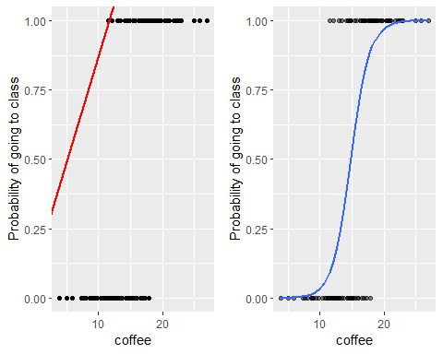

Slide 66
Logistic regression on Chácobo MFC
Try running a logistic regression model on the Chacobo Forced Experiment data, with the response as the dependent variable and the simulated Pitch (Hz) as the independent variable.
logit_model_01 <- glm(response~Pitch_Hz, data=df, family="binomial") summary(logit_model_01)

Slide 67
## Call: ## glm(formula = response ~ Pitch_Hz, family = "binomial", data = df) ## ## Coefficients: ## Estimate Std. Error z value Pr(>|z|) ## (Intercept) -9.109549 0.626233 -14.55 <2e-16 *** ## Pitch_Hz 0.075658 0.005149 14.70 <2e-16 *** ## --- ## Signif. codes: 0 '***' 0.001 '**' 0.01 '*' 0.05 '.' 0.1 ' ' 1 ## ## (Dispersion parameter for binomial family taken to be 1) ## ## Null deviance: 2242.6 on 1619 degrees of freedom ## Residual deviance: 1980.1 on 1618 degrees of freedom ## AIC: 1984.1 ## ## Number of Fisher Scoring iterations: 4

Slide 68
Interpreting the results
Apply the Divide by 4 rule to the slope coefficient
Interpret the intercept at the mean value for the Pitch (Hz)
Plot the logistic regression using ggplot()

Slide 69
Interpreting the slope
0.075658/4
## [1] 0.0189145
An increase in 0.02 Hz of pitch corresponds to the steepest rise in the probability of a Chácobo speaker chosing janáquë ’s/he vomited’ over jánaquë ‘ s/he left’ in the MCF

Slide 70
Interpreting the intercept
invlogit(-9.109549+ 0.075658*mean(df$Pitch_Hz))
## [1] 0.5287489
The probability of y (a Chácobo speaker chosing janáquë ’s/he vomited’ ) when pitch (Hz) is at its mean for the experiment (121.93 Hz) is 52% (when the first syllable is fixed at 80 Hz)

Slide 71
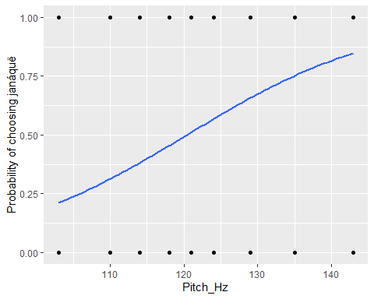
Plotting the loglinear relation
plotS<-ggplot(dat=df, aes(x=Pitch_Hz, y= response))+ geom_point(alpha=.5)+ stat_smooth(method="glm", se=FALSE, method.args = list(family=binomial))+ ylab("Probability of choosing janáquë") plotS

Slide 72
Dutch causative constructions
Predict which causative occurs in Dutch
data(doenLaten) d <- doenLaten head(d)
## Aux Country Causation EPTrans EPTrans1 ## 1 laten NL Inducive Intr Intr ## 2 laten NL Physical Intr Intr ## 3 laten NL Inducive Tr Tr ## 4 doen BE Affective Intr Intr ## 5 laten NL Inducive Tr Tr ## 6 laten NL Volitional Intr Intr

Slide 73
Dutch causative constructions
Predict which causative occurs in Dutch
data(doenLaten) d <- doenLaten head(d)
## Aux Country Causation EPTrans EPTrans1 ## 1 laten NL Inducive Intr Intr ## 2 laten NL Physical Intr Intr ## 3 laten NL Inducive Tr Tr ## 4 doen BE Affective Intr Intr ## 5 laten NL Inducive Tr Tr ## 6 laten NL Volitional Intr Intr
Doen relates to direct causation
Laten relates to indirect causation

